Slide 1
FLIGHT Price Prediction
- Harshil Goradia

Slide 2
Business Problems:
Anyone who has booked a flight ticket knows how unexpectedly the prices vary.
The cheapest available ticket on a given flight gets more and less expensive over time.
Time of purchase of ticket affects the price of the ticket.
People who book tickets at last minutes tend to pay more than average sometimes 2X or 3X price of ticket.

Slide 3
Data Processing:
I extracted the data from makemytrip.com using web scraping techniques and converted it into dataframe for further process. I scraped airline name, destination, source, departure time, arrival time, date, stops and price of the flight.
For cleaning the data, null values were replaced using simpleimputer assuming that replacing them won’t affect the model.
Splitted Journey date column into month and day, and departure and arrival time column into hours and minutes for better understanding and analysis.
The data type of the dataset was changed to float.
Later Encoded categorical columns using Label Encoder before scaling the dataset using MinMaxScaler.
After scaling, the dataset was ready for splitting into training and testing dataset for machine learning.

Slide 4
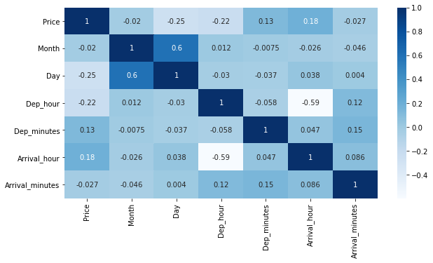
Here we can observe that Month and Day are the most co-related columns.

Slide 5
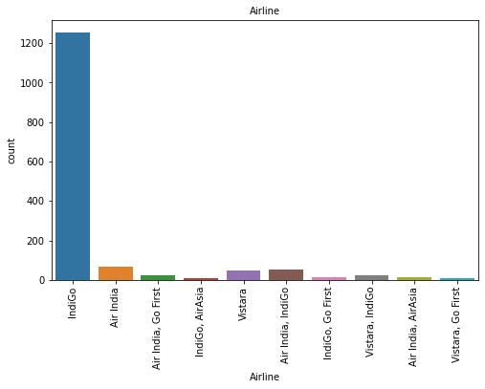
Indigo company has the highest number of flight counts.
Indigo combined with AirAsia has the lowest count of flights.
Air India has 2nd highest count of flights.
Combination of Air India and Indigo also has similar count of flights as Air India

Slide 6
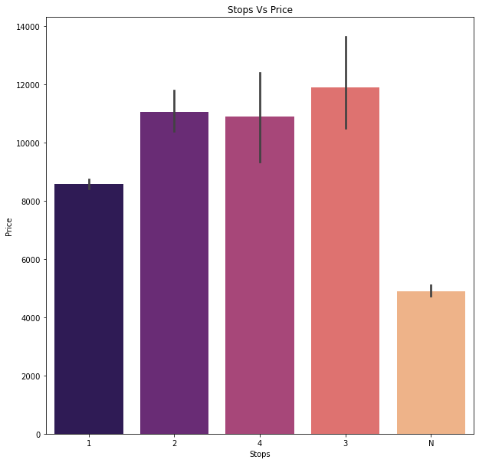
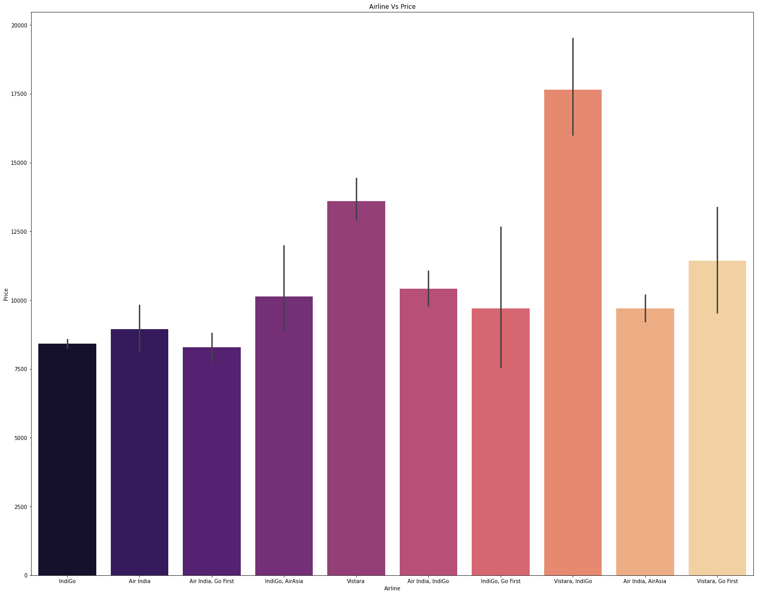
1. Vistara-Indigo is the most expensive combination airline. Vistara alone is also expensive than other airlines. Cheapest is the combination of Air India-Go First. 2. Flights which have 3 stops is the most expensive. Flights with no (N) stops are the cheapest.

Slide 7
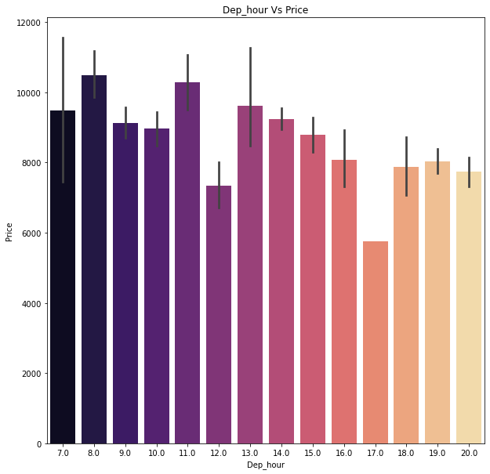
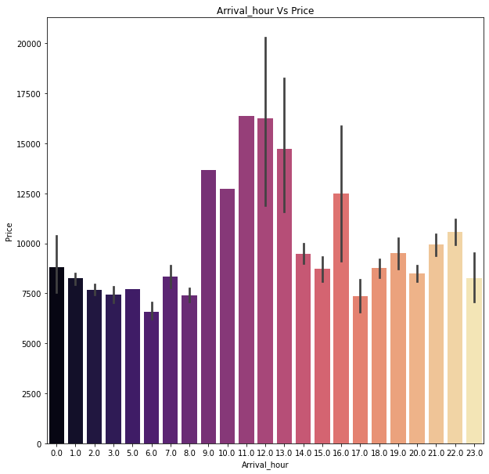
1. Flights which depart at 8am-9am and 11 am-12 noon are the most expensive. Flights at 5 o’clock in the evening is the cheapest flights.
2. The flights arriving in the middle of the day are most expensive flights.

Slide 8
Algorithms Used:
LinearRegression
RandomForestRegressor
DecisionTreeRegressor
AdaBoostRegressor
KneighborsRegressor

Slide 9
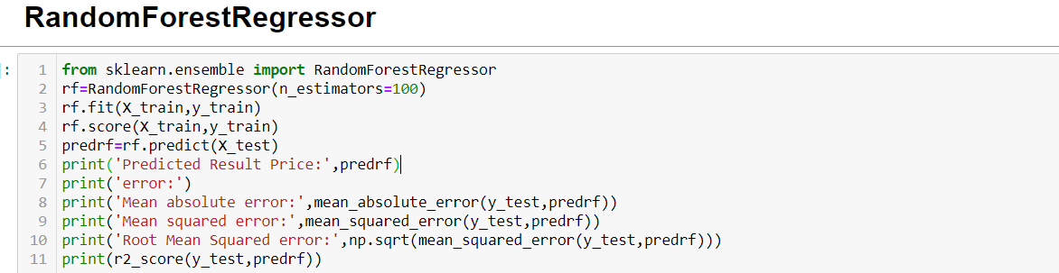
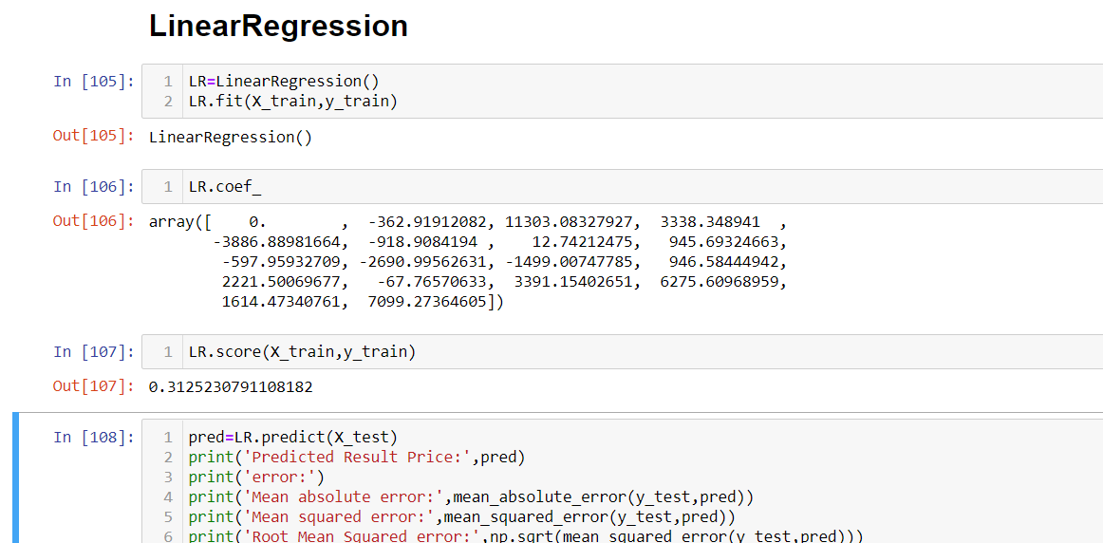
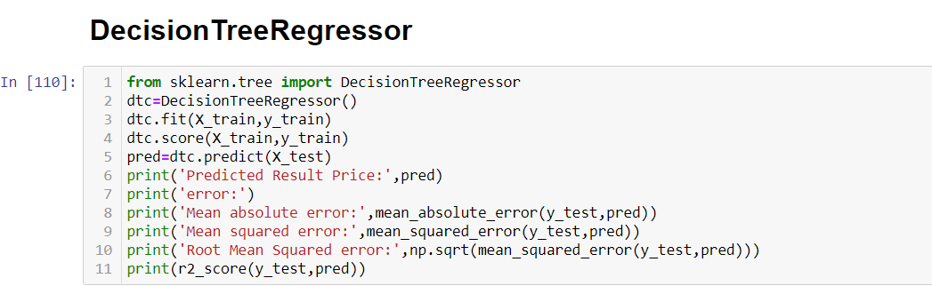
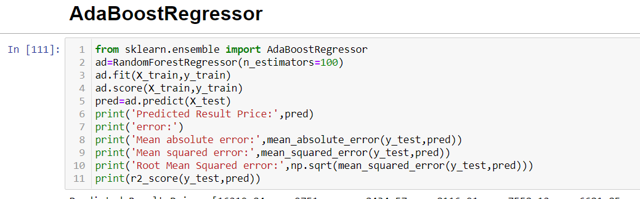
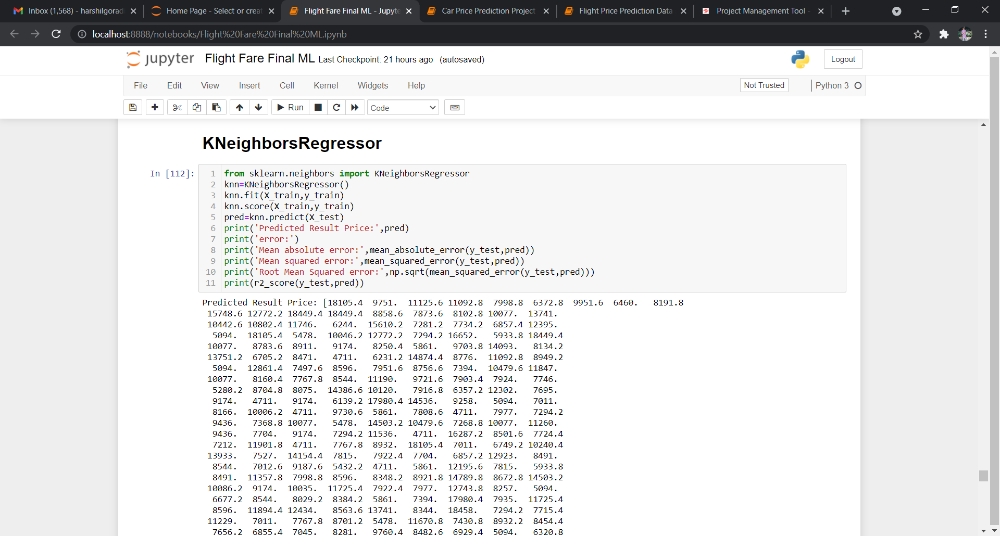
Mean absolute error: 963.7780745614035
Mean squared error: 2714382.525653188
Root Mean Squared error: 1647.5383229695108
Accuracy: 0.7774157593785039

Slide 10
Conclusion:
RandomForestRegressor has the highest accuracy score of 0.777. This means that more than 77% percent of the predicted prices of the flights were accurate.
Visualization plays important role in analysis of a dataset. Visualization guides data scientists to a proper direction for analysing the data. In this data set looking at the count of various features the following path was chosen.
Cleaning data increases the quantity of the data, but it affects the quality of the data. In the dataset of this project cleaning the data was important to make it efficient and remove the null values using simpleimputer.
Various algorithms were used to predict the price of the flights out of which RandomForestRegressor was best performing and LinearRegression was worst performing.

Slide 11
Steps:
Web Scraping using selenium.
Data Processing – Data importing, Data visualization, Data pre-processing, Machine Learning.
Imported data which was extracted by web scraping.
Used visualization tools to understand the data better.
Data pre-processing i.e. LabelEncoding and MinMaxScaler, were used for preparing the dataset for Machine Learning.
Machine Learning Algorithms were used to predict the best model for flight prices.
Hyper Parameter Tuning was done to find the best parameters for some algorithms.

Slide 12
Resources Used:
Jupyter Notebook - The whole project was done in jupyter notebook which provides python environment.
Selenium – Selenium was used for web scarping to extra data from makemytrip.com. This data was later used for analysis.
Pandas and Numpy - These libraries which are most important for an predictive analysis project. These libraries provide a function of shaping the data, importing the data, and viewing the data.
Matplotlib and Seaborn – These libraries were used for visualising the data in the entire project. All the visualization done in the project were done using either one of these libraries.
Sklearn – This library was the most used library as compared to other libraries. This library has been used in pre-processing for imputing numerical null values and for scaling the dataset. Later it was widely used for importing algorithms for machine learning and predicting.

